Slide 1

GaLa – Live every moment

Slide 2
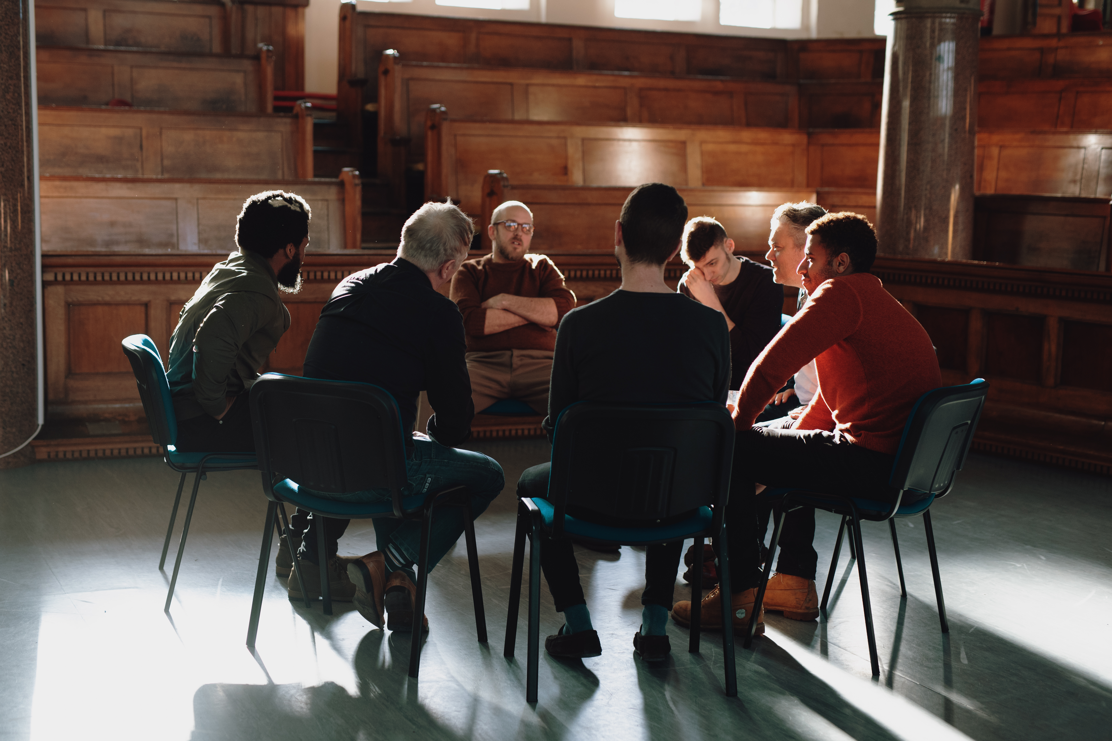
Co-Founders:
Ram Prasad Voleti
Alekhya Nangineni
Pranavi Adivi
Nikhila Gonuguntla
Revanth Krishna Cherukuri
Target Marketplace:
College institution/work organisation can use this application.
Value Proposition:
We offer Individual edition which is free of cost for a 10 groups and 20 members per group.
Premium Edition- It comes with unlimited groups and members in each group for $2/month.
Enterprise Edition – It includes premium features for users in an enterprise with $1 per user/month.

Slide 3

KEY WINNING FEATURES
News section for current and upcoming events.
Checklist to remind the necessary things.
Forum section to discuss about the ongoing activities.
Marketplace for their products to advertise.

Slide 4

CAPABILITIES
People can join the activities or events based on their interest.
News section provides information and helps in promoting the events.
Individuals are notified about events and activities.
Calendar synchronization of the events they join.
Offers a marketplace for the institutions to promote their products.
Highlights regarding events and recreational activities.

Slide 5
Workflow
User Login / Sign Up
View Activities, News section and Marketplace
Join Group
Access Checklist
Group Discussion Forum
Summary and highlights
Access Calendar
Logout

Slide 6

JUSTIFICATION
No competitors in the present market to address this pain.
There is a huge demand and need for an application that helps in promoting and organizing events.
Checklist is a unique and useful feature that reminds users of necessary things to bring or carry to the activities.

Slide 7
CONCLUSION AND IMPLEMENTATION STRATEGY
The primary purpose of this application is to provide a user-friendly platform for recreational services that can be used by a variety of organizations and institutions. We also encourage people to engage in activities that they are passionate about. We've also added a news area to help people stay informed about current and upcoming events. People will be notified via sending notifications and synchronizing their calendars, which will pique their interest. The highlights and overview of the activity are also discussed. We also offer a marketplace for organizations to advertise their products, promotions, and event tickets, among other things.
10/16/21 | Data Gathering & Identifying key features | Nikhila, Ram
11/3/21 | Development, implementation of features | Alekhya, Revanth
11/22/21 | Design User interface, Backend | Ram, Pranavi
11/28/21 | Testing and validation | Nikhila, Alekhya, Revanth
12/4/21 | Deployment, Documentation | Whole team

